Slide 1

Ideas in Motion A Journey into the world of Generative AI
Understanding with Hands-on!

Slide 2
Agenda
01
02
03
Idea: Understanding Generative AI to enable Business Idea Generation
Large Language Models (LLM)
Retrieval Augmented Generation (RAG)
04
Prompting
Capabilities and
Generating Ideas!

Slide 3
You shall know a word by the company it keeps.
- John Rupert Firth (1957)

Slide 4
What is Generative AI?
Generative AI refers to artificial intelligence systems and models that have the ability to generate new content, such as images, text, or other types of data.
Trained on large datasets and learn patterns and structures from the data, enabling them to generate new, realistic content that is similar to what they were trained on.
Multimodal models are a type of generative AI that can handle and generate content in multiple modalities, such as text, images, and sometimes audio. These models are designed to understand and generate information across different types of data, allowing them to create coherent and meaningful outputs that involve multiple modalities.
Language Models (LLM): Language models, like GPT-3, are primarily focused on generating and understanding natural language text..
Diffusion-based Models: Diffusion-based models, on the other hand, belong to a different class of generative models that use a different approach for generating content, often applied to other modalities like images.

Slide 5

01
Large Language Models
What is a Language Model!!?

Slide 6
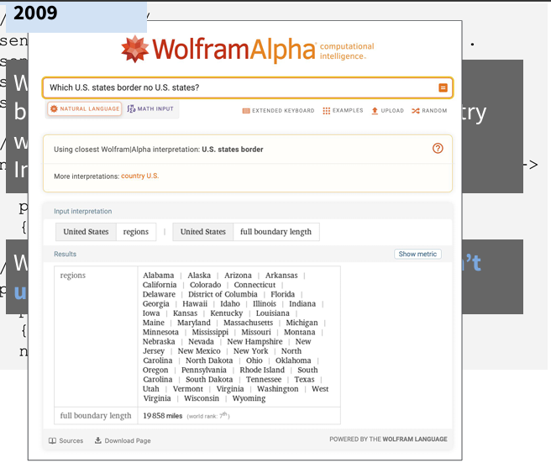
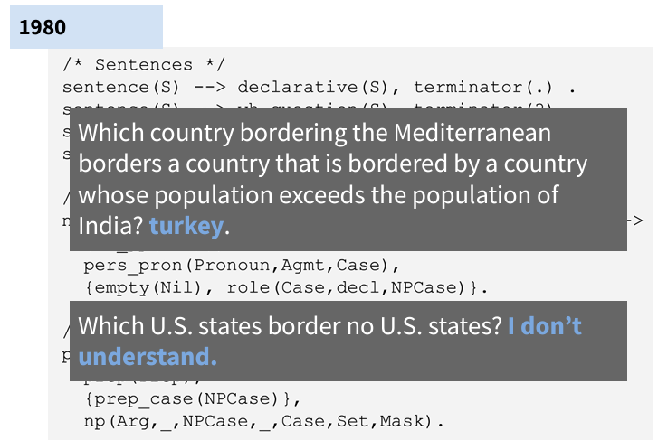
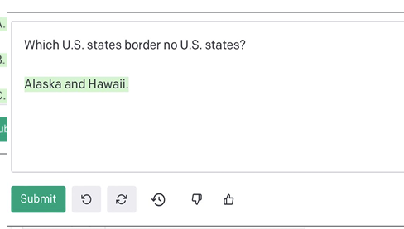
Language Model
Understanding the World of AI before LLM’s (2010 +)
Prior to 2010, Rule based and Statistical approaches were prevalent, then came Deep Learning Era…
2023

Slide 7
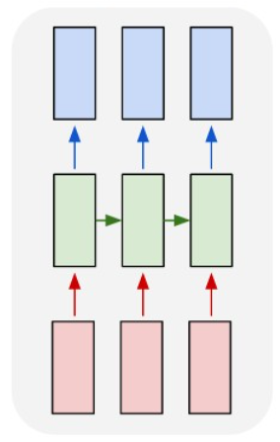
Language Model
The Deep Learning Era
A Recurrent Neural Network (RNN) used to Process Sequential (text) data.
Task: Machine Translation will Take input in a language and generate translation in another.
Labelled Data is required
Context Length: ~ 7 words
LSTM – An improvement over RNN – 100 words
Transformers and Attention ~ 1000 words (vague approximation)

Slide 8
Problems?
Lot of Labelled Data Required
Context Length is Limited

Slide 9
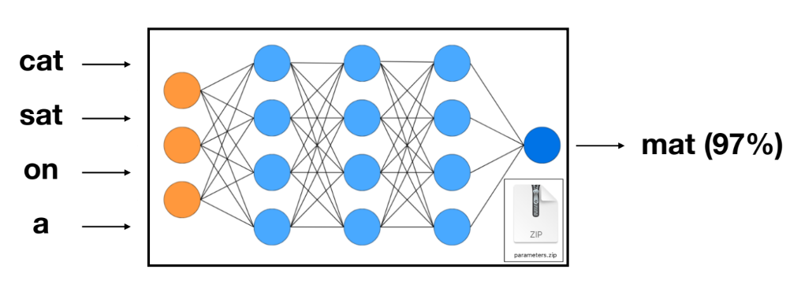
Enters …Large Language Model
An Language Model is a Transformer based Neural Network Architecture that predicts the next word!
Tech Note: Same as an n-gram ANN Model (RNN based)

Slide 10
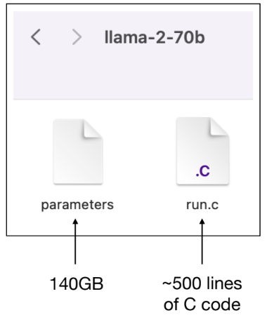
Enters …Large Language Model
No Labelled Data Required – Uses Internet Raw Data
I am Learning ____ AI
I __ learning Generative AI
Transformer Architecture + Other Techniques for Context Length (Used in GPT)

Slide 11
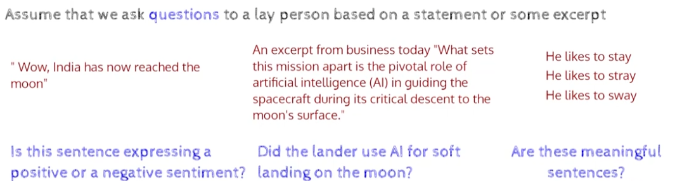
Since a Language Model Predicts the next word, it has the ability to Understand Language!
We develop a strong understanding of Language through Reading, without being specifically trained on a Task.

Slide 12
Idea
Pretraining
Pretraining is Training a Language Model on Lots on unlabelled data, rather than on a specific task.
-The GPT (Generative Pretrained Transformer) uses Pretraining
Transfer Learning
Once you have a Basic idea of Task 1, we can use that knowledge to Learn a Specific Task.
“Transfer Learning is the Idea of the Century” – Lex Friedman

Slide 13
Current Quests: Path to AGI!
Context Size
Probability Pred
Freshness
How do we increase the Context Size Further? Read an entire book?
How do we Predict Probs better? Predict the Best? Plan (Q*)?
Adding Randomness and generating New Ideas?
Biases
Hallucination
Size
How do we remove Varios Biases?
Breaking out of Probability Loop
Reduce Size?

Slide 14

02
RAG Approach
Why We need Retriveal Augmented Generation?

Slide 15
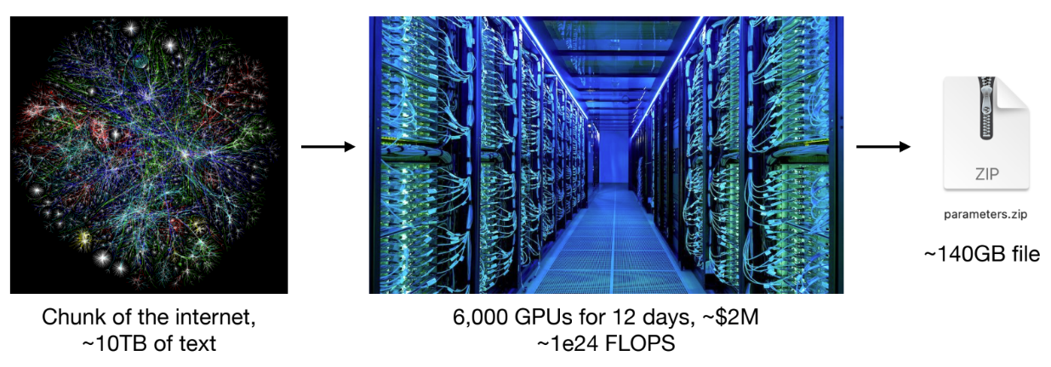
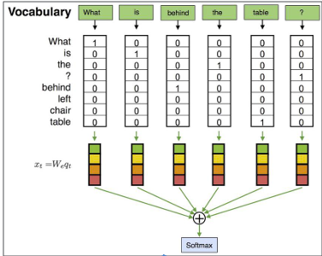
Idea
Embeddings
The Final Understanding of the Model (Vectors) before it Calculates Probabilities, are Embeddings
Embeddings
Output Probability

Slide 16
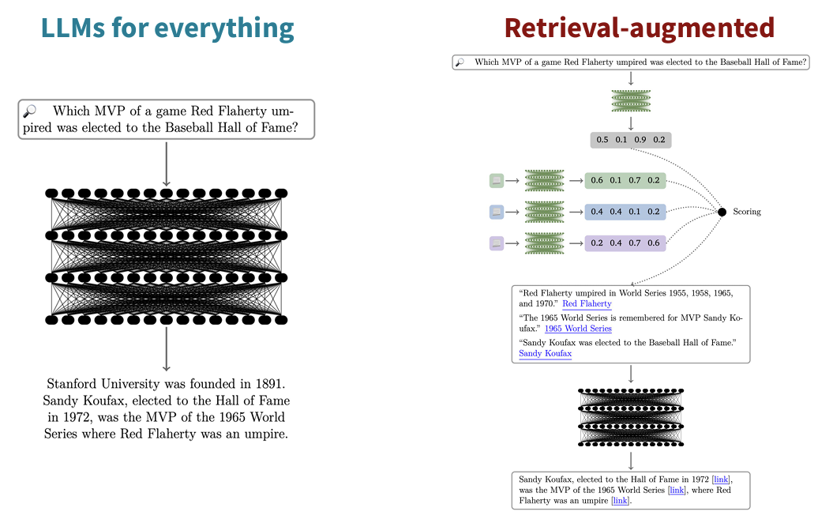
Retrivel Augmented Generation
LLM = Language Knowledge + World Knowledge
RAG - The idea to separate and store World Knowledge separately and use it.
Embeddings are stored into a Separate Vector Database, and LLM Acts as a Search Engine to Retrieve them based on User Queries!

Slide 17
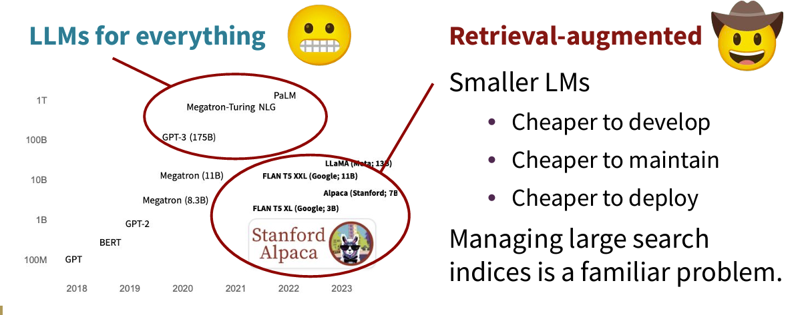
Retrivel Augmented Generation

Slide 18
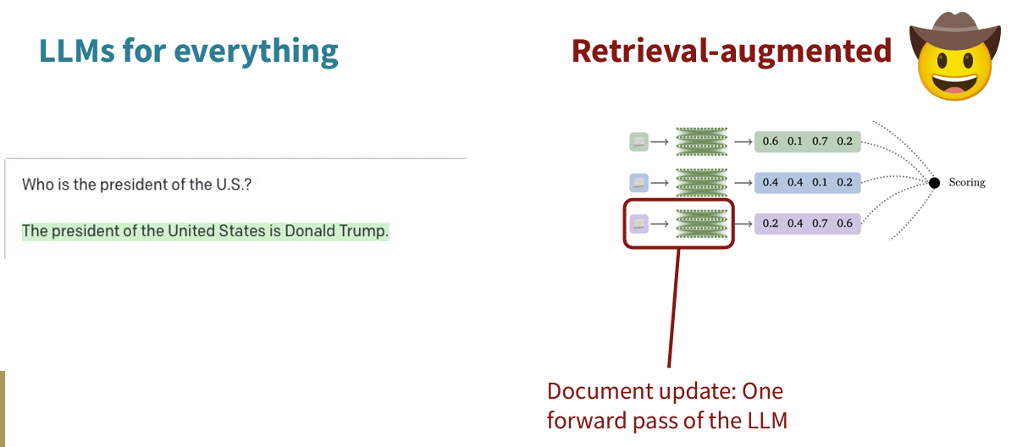
Retrivel Augmented Generation
RAG uses Updated Information.

Slide 19
03
Prompting
Coding an LLM in English!

Slide 20
Prompting
When we prompt a language model, we put it in a temporary state, and then you generate a sample from the model.
• Better late than __________
• Every day, I eat breakfast, lunch, and __________
• The President of the U.S. is __________
• The key to happiness is __________

Slide 21
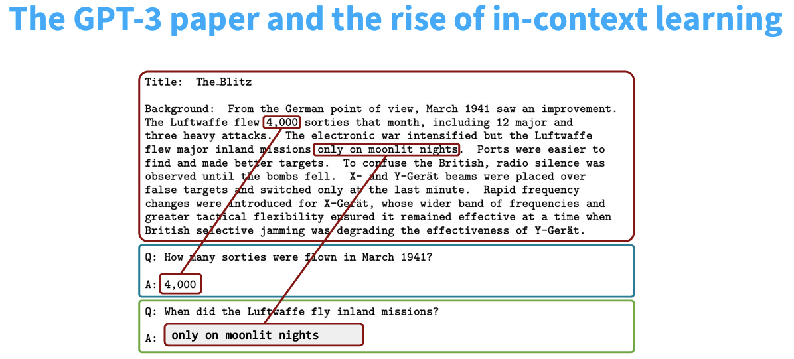
Prompting

Slide 22
Prompting

Slide 23
04
Capabilities and Ideas
What we can Do!

Slide 24


Presented By:
Ankur Gupta
Ravi Dhir
PMP Professional
M.Tech in AI from Bits
Stanford Certified
MS in AI from Liverpool John Moores

Slide 25
RESOURCES
Andrej Karpathy – Various Blogs and YouTube Channel
Stanford AI – CS224U and CS224N
IITM –Prof. Mitesh Khapra’s Lectures

Slide 26
THANKS!
Please keep this slide for attribution

